Slide 1
Parallel Programming in Python – a very, very short introduction
Agenda
Computer architectures, data structures, and opportunities
Case 1 – computing the average of a very large sample
Case 2 – computing a sparse document/term matrix
Case 3 – computing a dense distance matrix

Slide 2
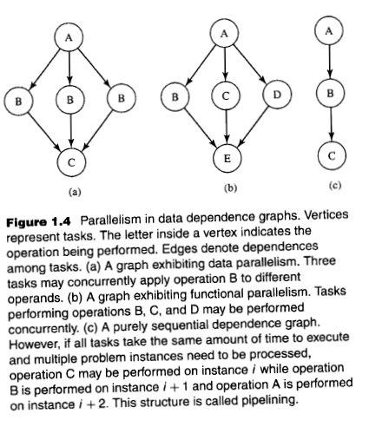
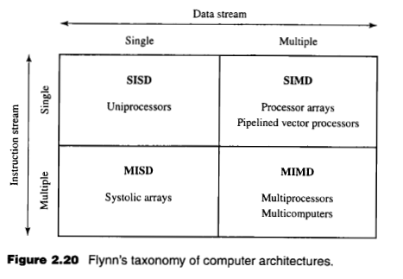
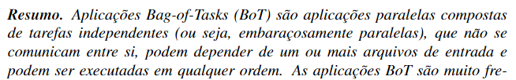


The scope of the technique that will be presented:

Slide 3

Case 1 – computing the average of a very large sample

Slide 4

Case 1 - computing the average of a very large sample
Attributes obtained from the same individual
(sample)
height
weight
Sequential execution, main core
BMI
$$BMI=\frac{weight}{{height}^{2}}$$

Slide 5
Case 1 - computing the average of a very large sample
Attributes obtained from the same individual
(sample)
height
weight
Parallel execution
core 1
Parallel execution
core 2
Parallel execution
core 3
Parallel execution
core 4
BMI
$$BMI=\frac{weight}{{height}^{2}}$$

Slide 6
Case 2 – computing a dense distance matrix

Slide 7
To resume in a future meeting ;)

Slide 8
Case 3 – computing a sparse document/term matrix

Slide 9
To resume in a future meeting ;)

Slide 10
Parallel Programming in Python – a very, very short introduction
Thanks!

Slide 11
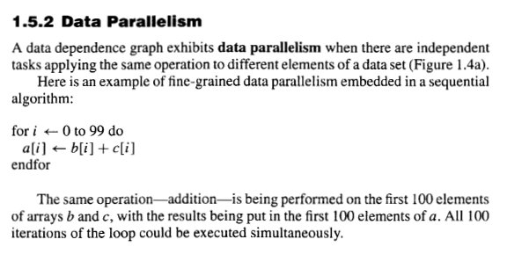
Bag of Tasks

Slide 12
